Slide 2


Overview

Slide 3
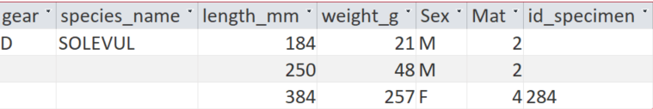
Normal procedure for target species

Slide 4

 | Individual length | Individual weight | Total weight | Total number
Target | X | X
Non target | X |  | X
Non target shellfishes |  |  | X | X

Slide 5
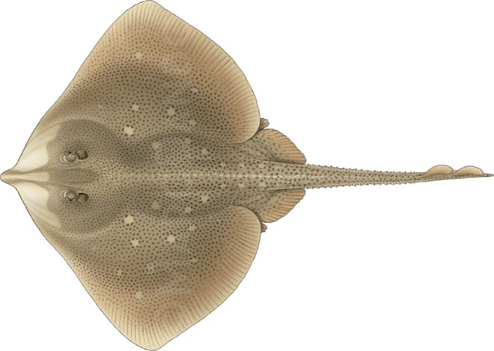

Disc width
Disc length
Total length
Total length
Disc length
Disc width

Slide 6
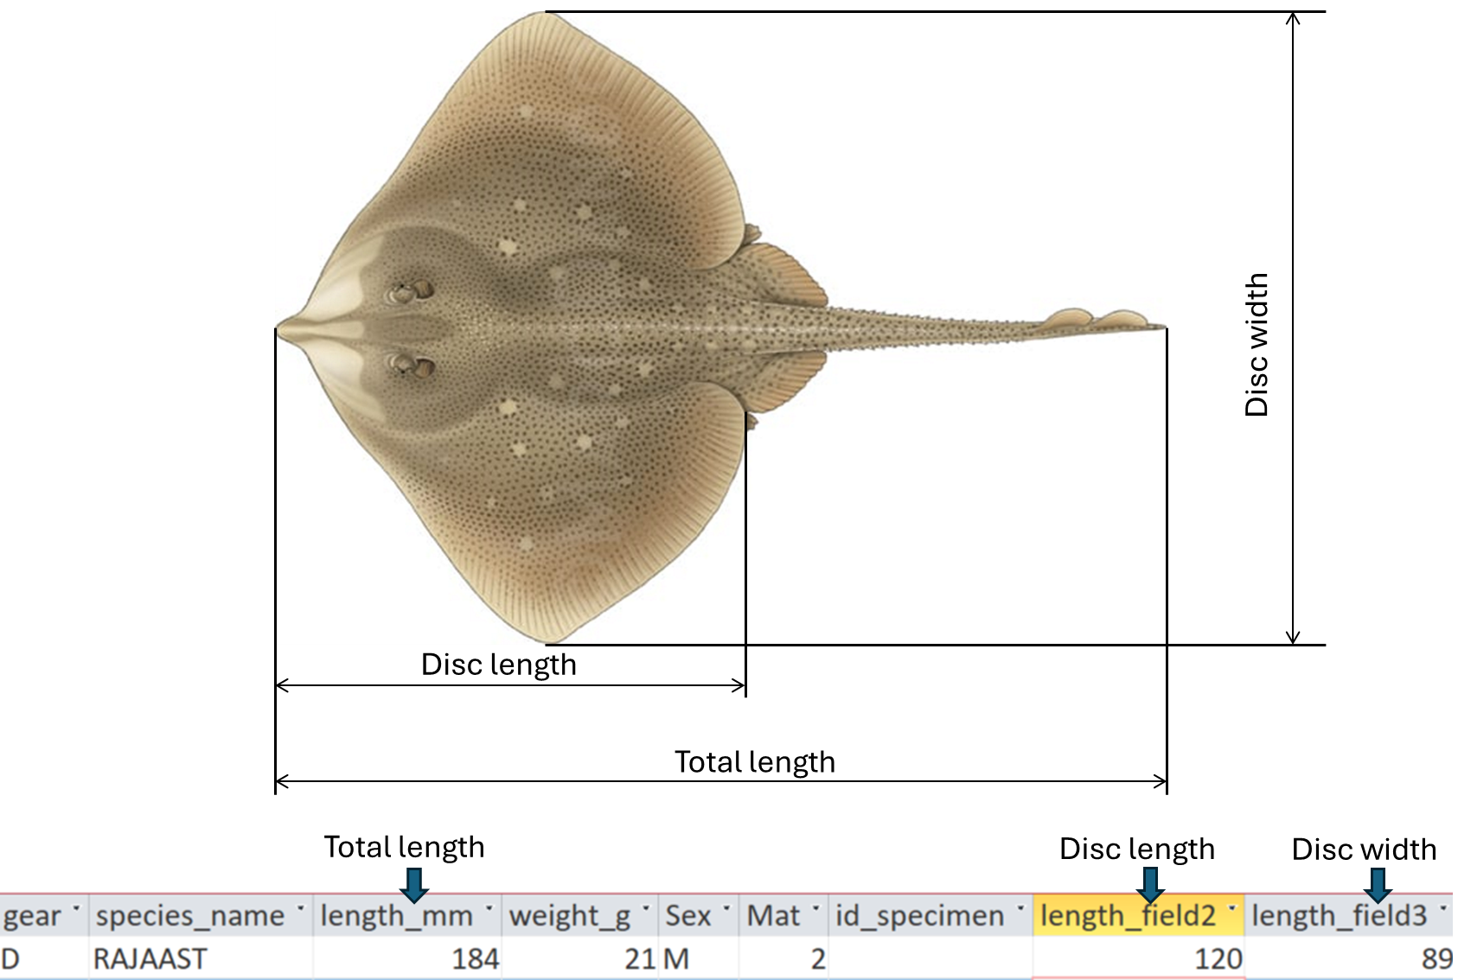

Slide 7
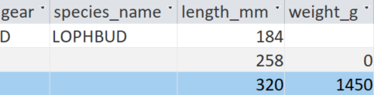


Slide 8
Subsamples are collected when the catches from a species are too high to be processed entirely. The detailed information obtained from subsample (e.g.: individual length, individual weight, number of individuals) must be raised to the total catch.
There can be different cases to handle subsamples, depending on (i) the type of species (target, non target, non target shellfish); and (ii) the modality used to collect the subsample.
Data are to be given according to the specific case. Therefore it is important to understand what are we doing.

Slide 9
C1_species
Sorted sample
(all the specimen for species x that were in the haul)
Sorted Subsample
(some specimen of species x from the sorted subsample)
Unsorted Haul
C2_haul
Unsorted Subsample
Sorted Subsample
(all specimen of species x that were in the unsorted subsample)
Unsorted Haul
C3_benthos
Haul without fish, commercial invertebrates and litter (Partially sorted haul)
Partially sorted Subsample
Sorted Subsample
(all specimen of species x that were in the unsorted subsample)
Unsorted Haul
C4_multiple
Partially sorted sample
(all the specimens of more than one species)
Partially sorted subsample
(some specimens of more than one species from the partially sorted sample)
Sorted subsamples
(divide the partially sorted subsample by species)
Sorted sub-subsamples
(some specimens from each sorted subsample)
Unsorted Haul

Slide 10
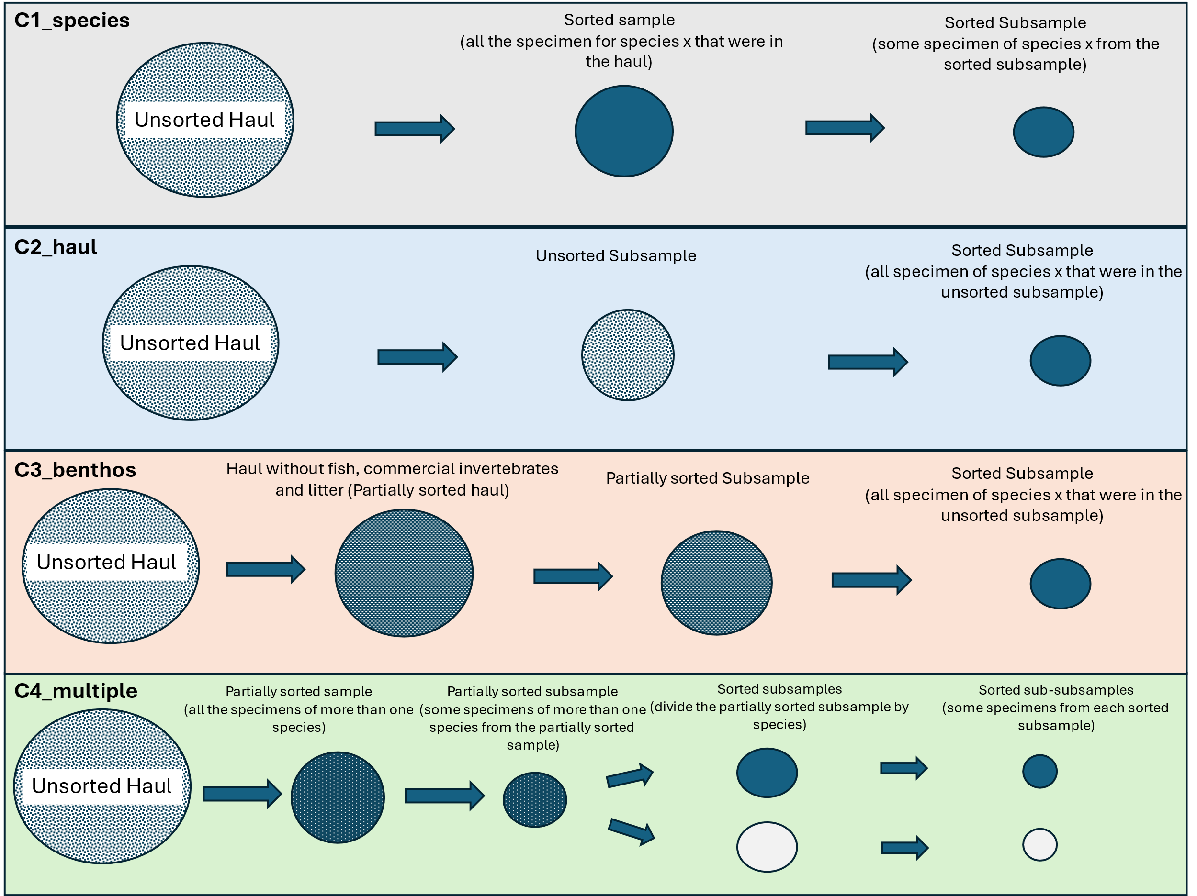

Slide 11


NON TARGET SPECIES (example for MUREBRA)
C1_species
Sorted sample
(all the specimen for species x that were in the haul)
Sorted Subsample
(some specimen of species x from the sorted subsample)
Unsorted Haul
1 - Weight of the sorted sample
2 - Weight of the sorted subsample
Information collected
3 - Number of individuals in the sorted subsample
Reporting in access

Slide 12
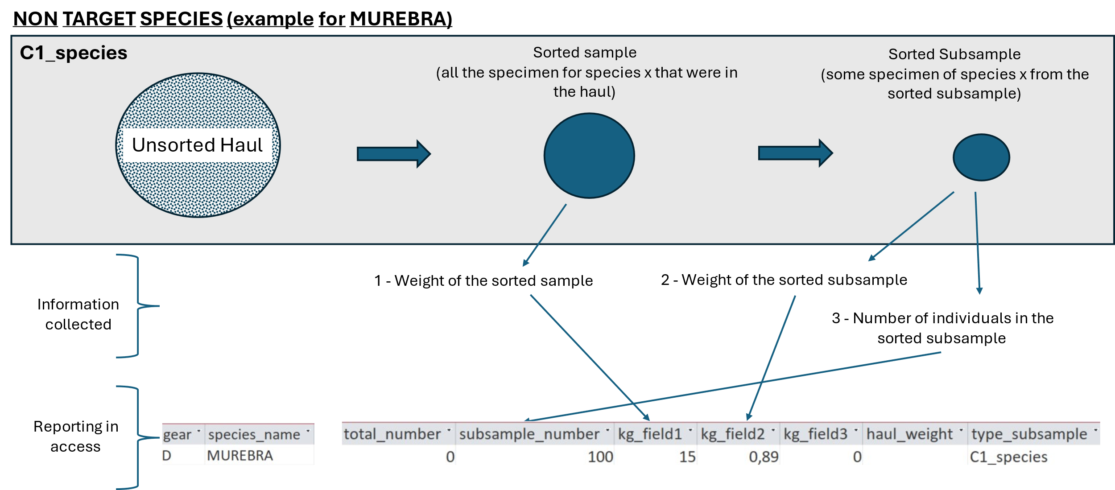

Slide 13

NON TARGET SPECIES (example for MUREBRA)
C2_haul
Unsorted Subsample
Sorted Subsample
(all specimen of species x that were in the unsorted subsample)
Unsorted Haul
1 - Weight of the haul
2 - Weight of the unsorted subsample
3 - Weight of the sorted subsample
Information collected
4 - Number of individuals in the sorted subsample
Reporting in access

Slide 14
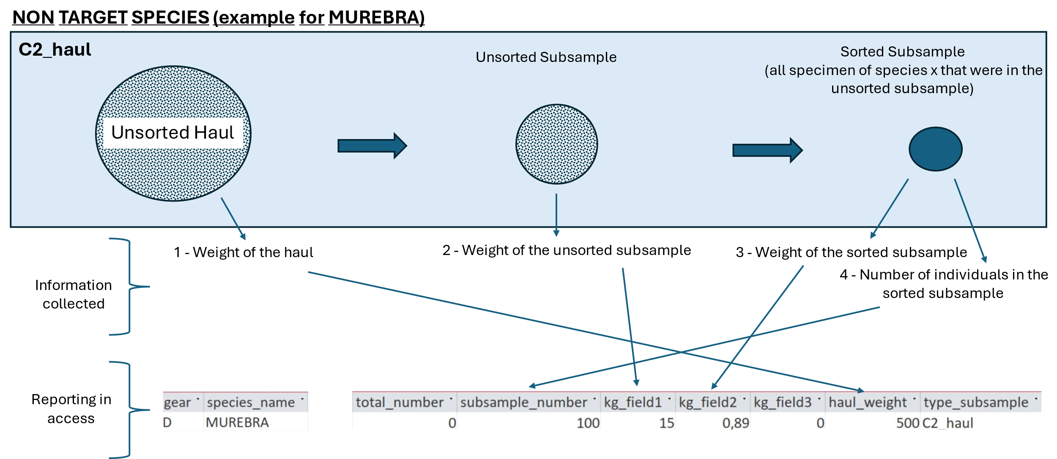

Slide 15

NON TARGET SPECIES (example for MUREBRA)
C3_benthos
Haul without fish, commercial invertebrates and litter (Partially sorted haul)
Partially sorted Subsample
Sorted Subsample
(all specimen of species x that were in the unsorted subsample)
Unsorted Haul
1 - Weight of the haul
2 - Weight of the partially sorted subsample
3 - Weight of the sorted subsample
Information collected
4 - Number of individuals in the sorted subsample
Reporting in access

Slide 16
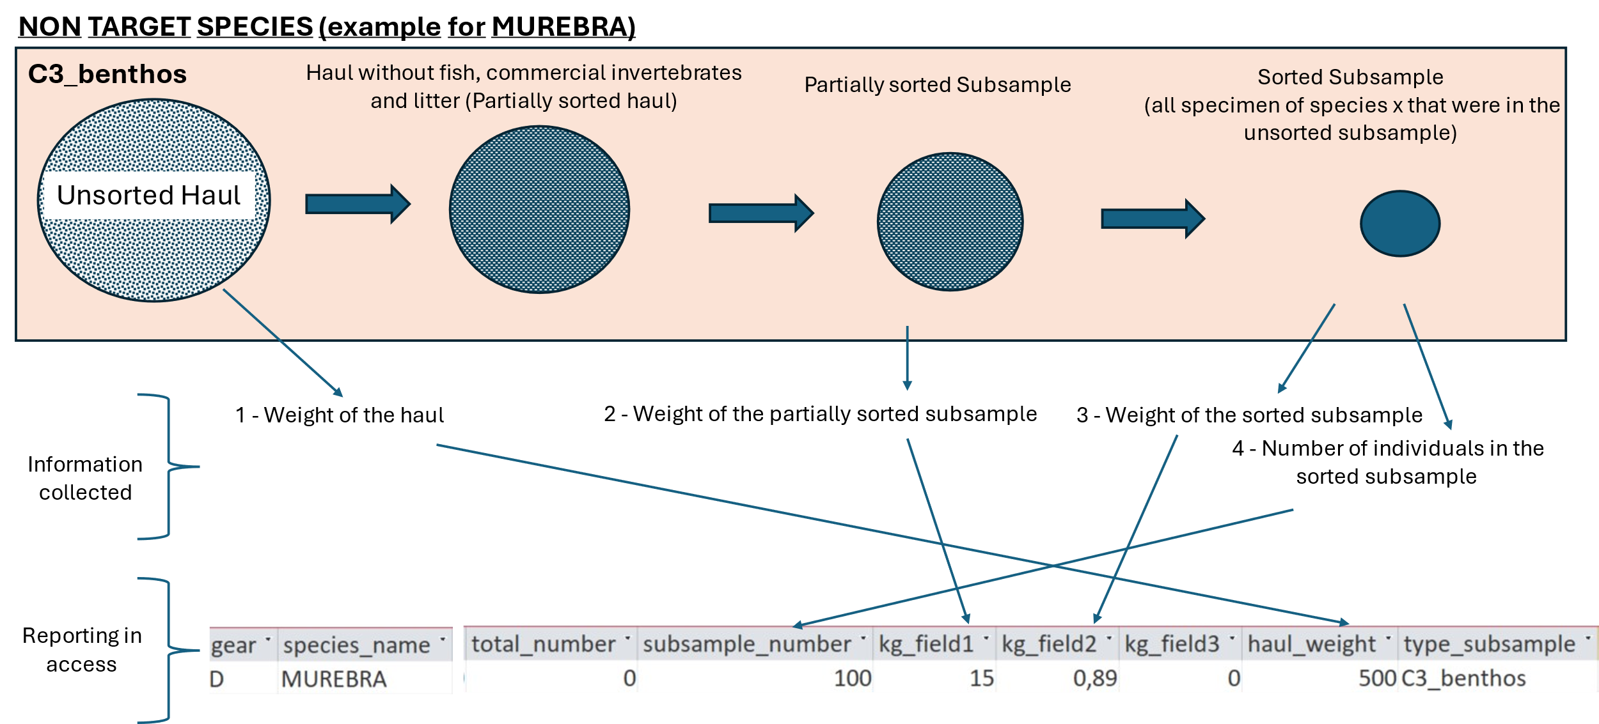

Slide 17
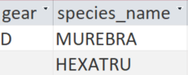
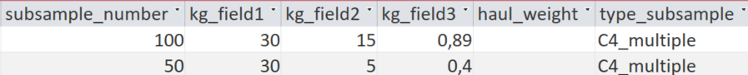
NON TARGET SPECIES (example for MUREBRA and HEXATRU)
C4_multiple
Partially sorted sample
(all the specimens of more than one species)
Partially sorted subsample
(some specimens of more than one species from the partially sorted sample)
Sorted subsamples
(divide the partially sorted subsample by species)
Sorted sub-subsamples
(some specimens from each sorted subsample)
Unsorted Haul
1- Weight of the partially sorted sample
2 - Weight of the sorted subsample
3 - Weight of the sorted sub-subsample
Information collected
4 - Number of individuals in the sorted sub-subsample
Reporting in access

Slide 18
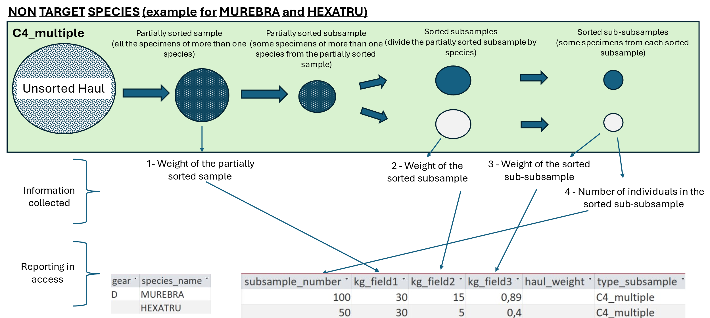

Slide 19
Target species

Slide 20
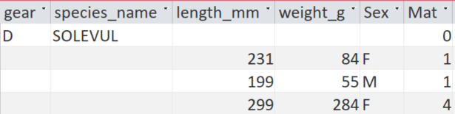
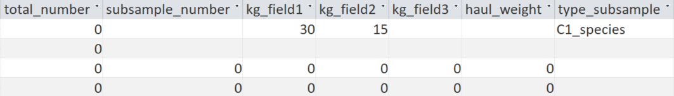
TARGET SPECIES (example for AEQUOPE)
C1_species
Sorted sample
(all the specimen for species x that were in the haul)
Sorted Subsample
(some specimen of species x from the sorted subsample)
Processing individual length and weight using default method for target species
Unsorted Haul
1 - Weight of the sorted sample
2 - Weight of the sorted subsample
(Optional. If this is not feasible it will be reconstructed as the sum of the individuals)
Information collected
Reporting in access
Processing individual length and weight

Slide 21
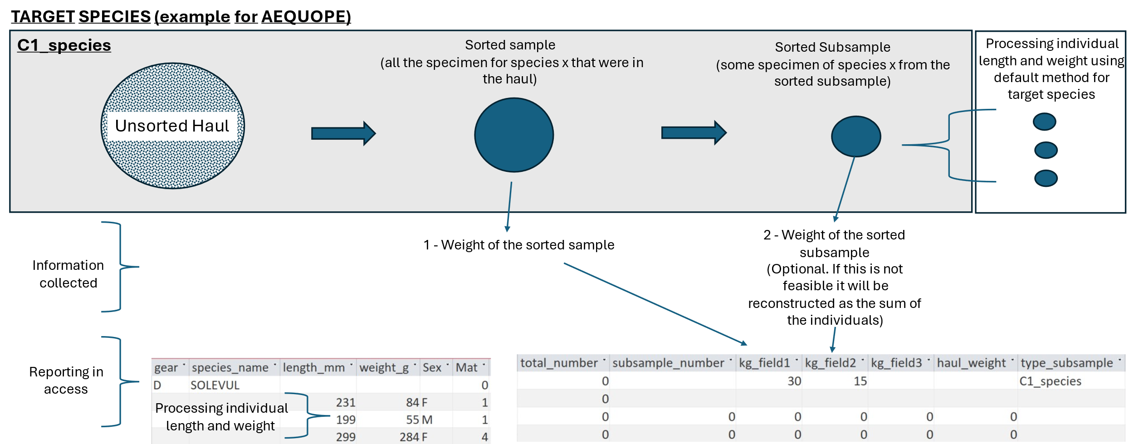

Slide 22

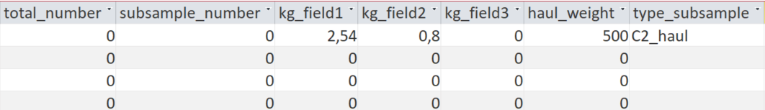
TARGET SPECIES (example for AEQUOPE)
C2_haul
Unsorted Subsample
Sorted Subsample
(all specimen of species x that were in the unsorted subsample)
Processing individual length and weight using default method for target species
Unsorted Haul
1 - Weight of the haul
2 - Weight of the unsorted subsample
3 - Weight of the sorted subsample (Optional. If this is not feasible it will be reconstructed as the sum of the individuals)
Information collected
Reporting in access
Processing individual length and weight

Slide 23
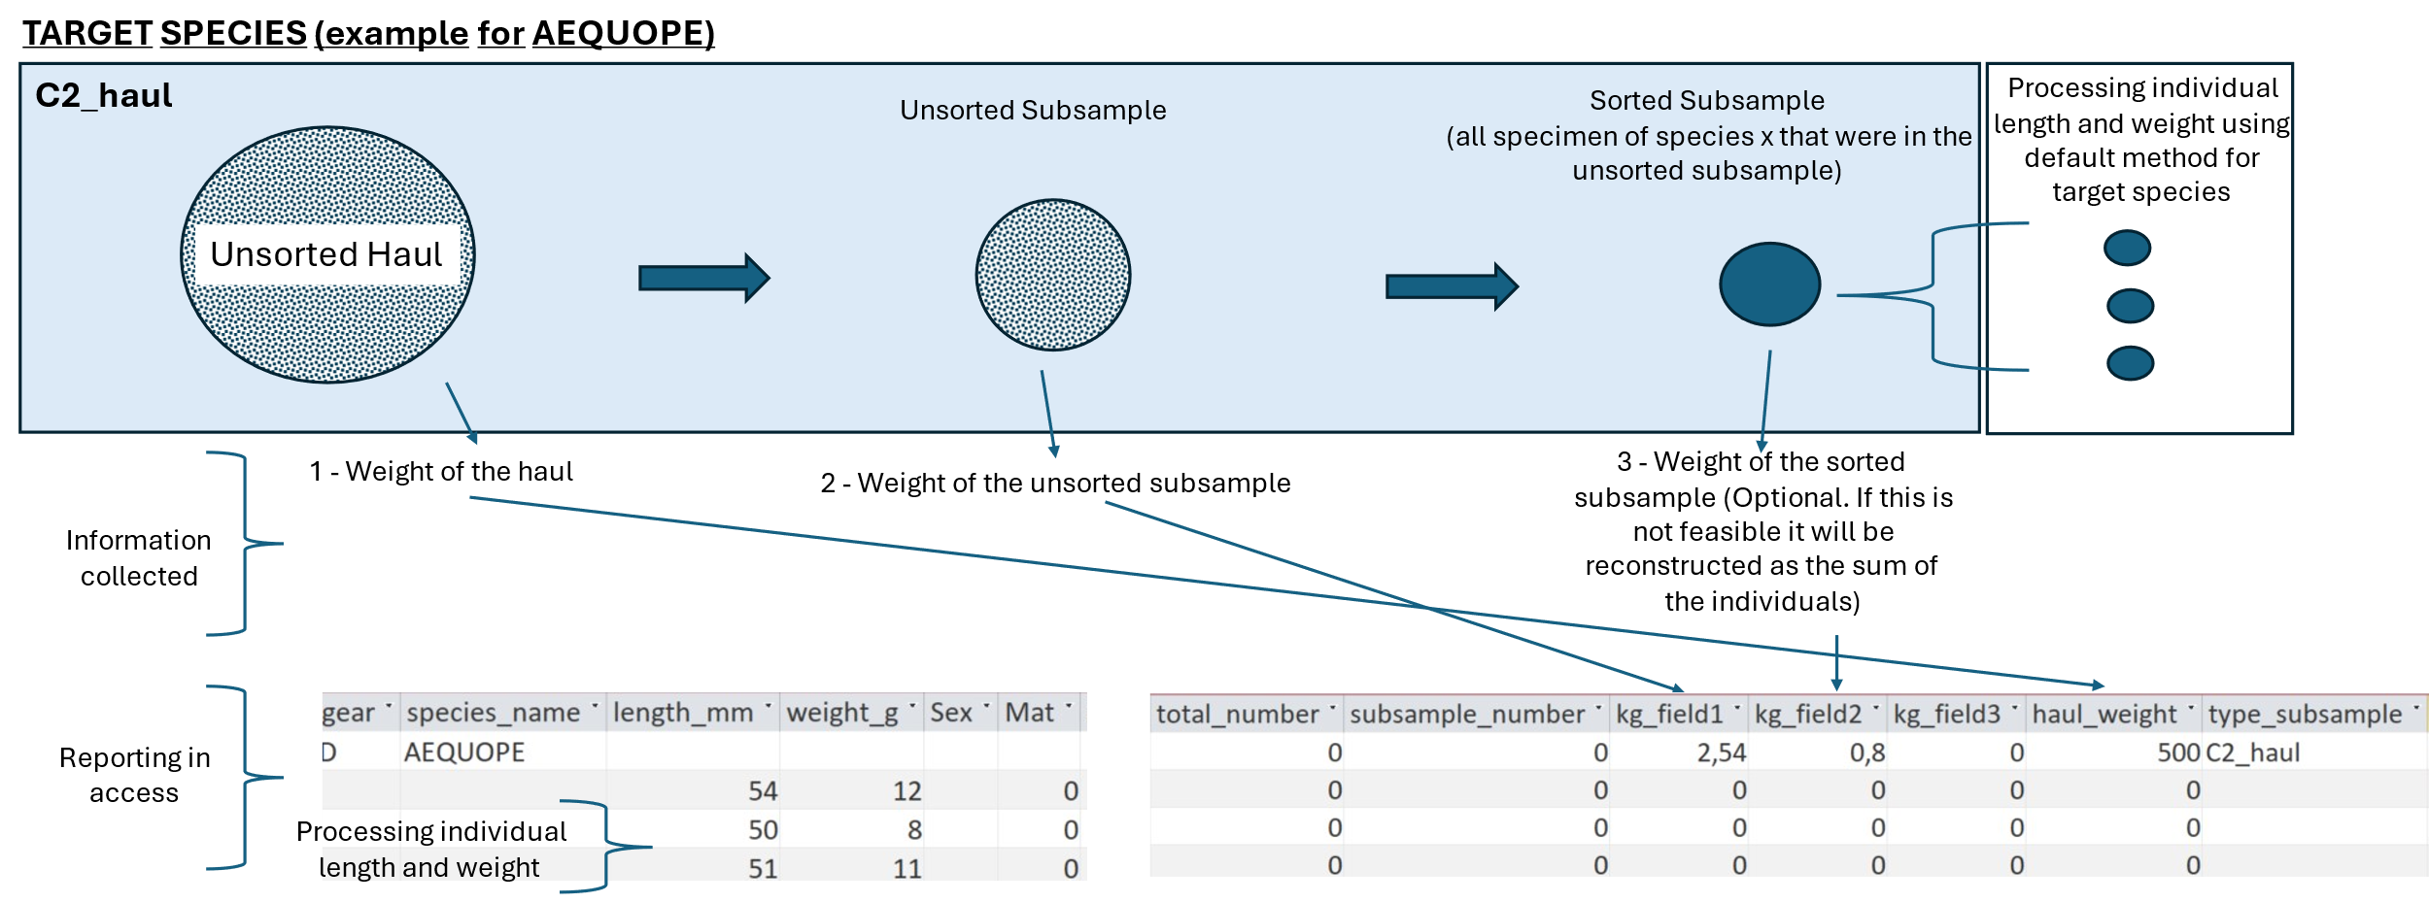

Slide 24
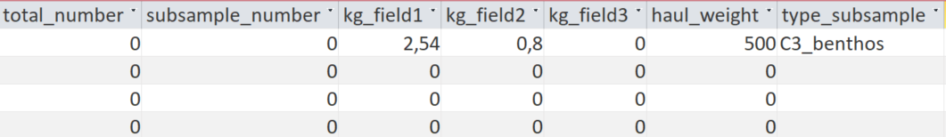
TARGET SPECIES (example for AEQUOPE)
C3_benthos
Haul without fish, commercial invertebrates and litter (Partially sorted haul)
Partially sorted Subsample
Sorted Subsample
(all specimen of species x that were in the unsorted subsample)
Processing individual length and weight using default method for target species
Unsorted Haul
3 - Weight of the sorted subsample (Optional. If this is not feasible it will be reconstructed as the sum of the individuals)
1 - Weight of the haul
2 - Weight of the partially sorted subsample
Information collected
Reporting in access
Processing individual length and weight

Slide 25
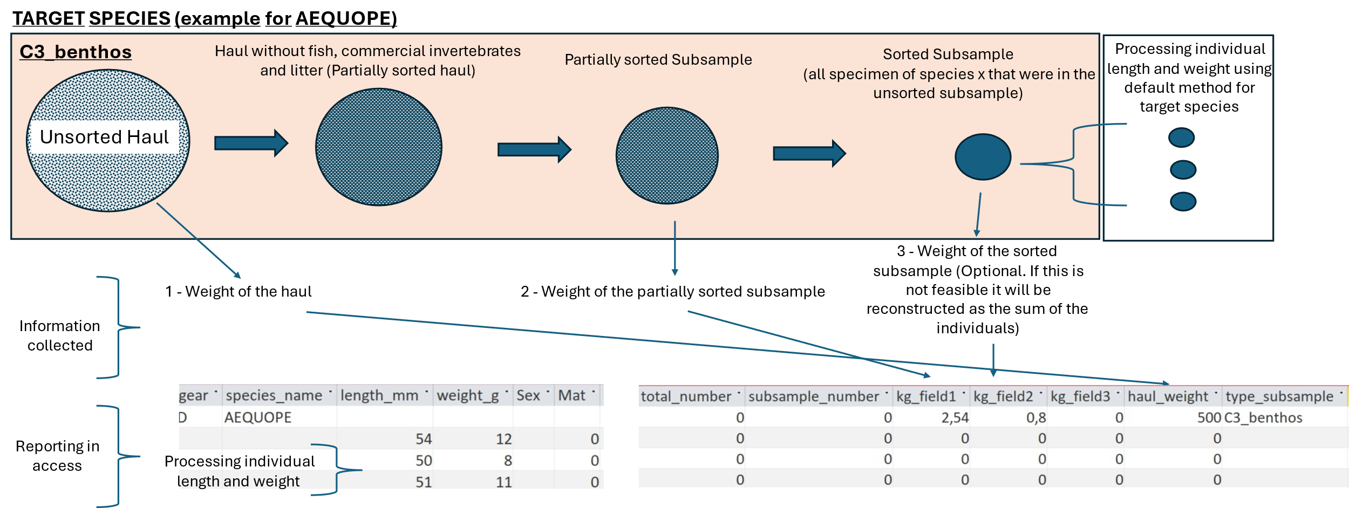

Slide 26
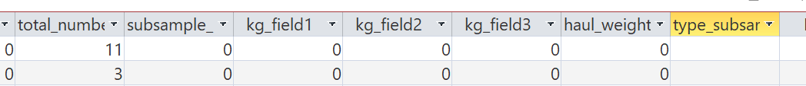
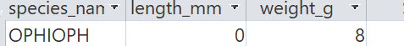
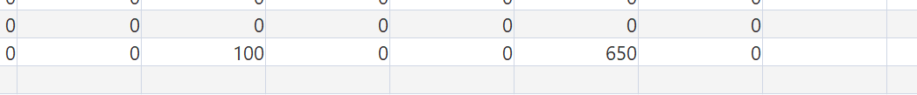
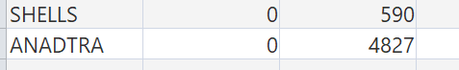
BENTHOS_1
Sorted Subsample
(all specimens of the species are separated from the benthos subsample)
Benthos Subsample
Unsorted species subsample
(We count 100/50 specimens and weigh them)
Unsorted Haul
Information collected
Weight= sample species
Numbers= subsample number
Weight-100/50
Reporting in access

Slide 27
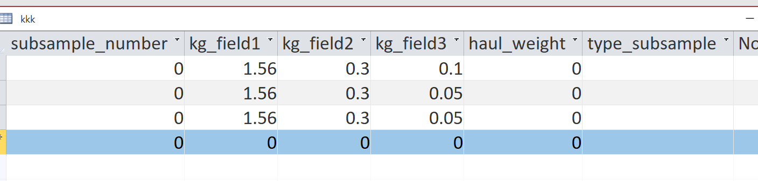
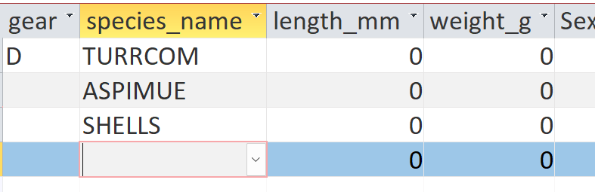
BENTHOS_2 (Turritella communis and Aporrhais pespelecani)
Sorted Subsample
(all specimens of the species are separated from the benthos subsample)
species subsample
(We count 100/50 specimens and I break the shell)
A
Unsorted Haul
B
Benthos Subsample
shells
Weight= subsample species
Information collected
Weight= sample species
Numbers = subsample numbers
Weight= subsample species
Reporting in access
30

Slide 28
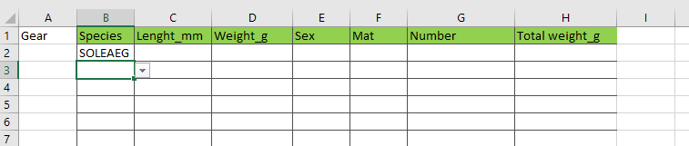

Slide 29
162
120
M
3
SQUIMAN
23
M
If it is not possible to indicate the individual weight,
leave the box blank and do not indicate the total weight

Slide 31
ARNOLAT
67
78
89
134
BUGLUTT
90
99
If there is only one individual, fill in length and weight.

